Slide 1
Morphological Image Processing: Erosion, Dilation

Slide 2
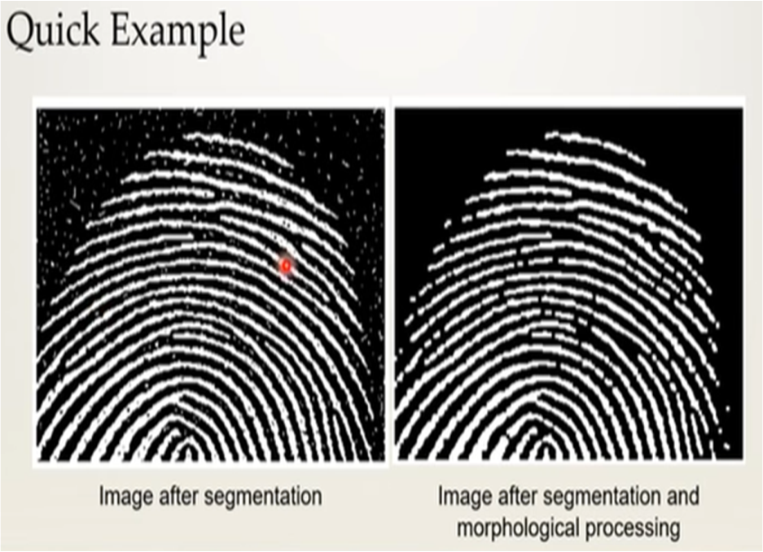
The word morphology refers to the scientific branch that deals the forms and structures of animals/plants.
Morphology in image processing is a tool for extracting image components that are useful in the representation and description of region shape, such as boundaries and skeletons.
Furthermore, the morphological operations can be used for filtering, thinning and pruning.
The language of the Morphology comes from the set theory, where image objects can be represented by sets. For example an image object containing black pixels can be considered a set of black pixels in 2D space of Z².

Slide 3
Morphological operations are used to extract image components that are useful in the representation and description of region shape.
Morphological operations are some basic tasks dependent on the picture shape.
It is typically performed on binary images.
It needs two data sources, one is the input image, the second one is called structuring component.
Morphological operators take an input image and a structuring component as input and these elements are then combines using the set operators.
The objects in the input image are processed depending on attributes of the shape of the image, which are encoded in the structuring component.
Types of Morphological operations:
Dilation: Dilation adds pixels on the object boundaries.
Erosion: Erosion removes pixels on object boundaries.
Open: The opening operation erodes an image and then dilates the eroded image, using the same structuring element for both operations.
Close: The closing operation dilates an image and then erodes the dilated image, using the same structuring element for both operations.

Slide 4
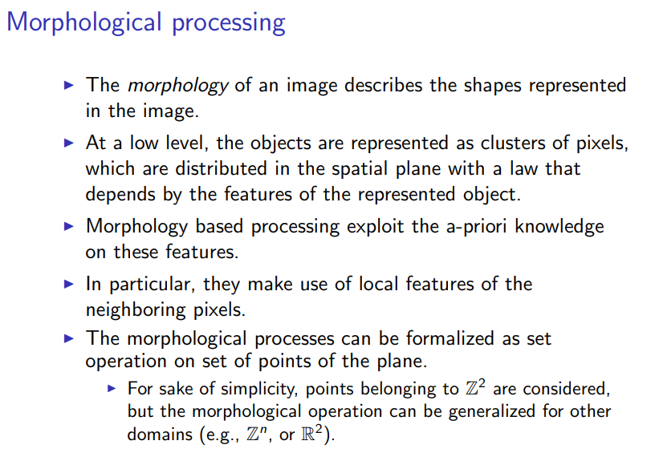

Slide 5
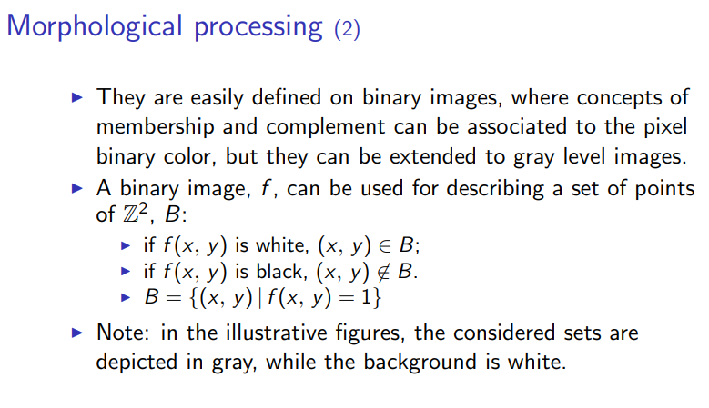

Slide 6
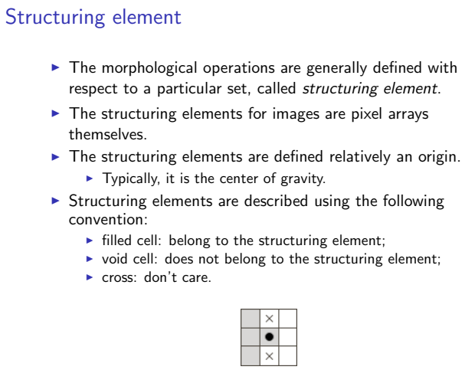

Slide 7
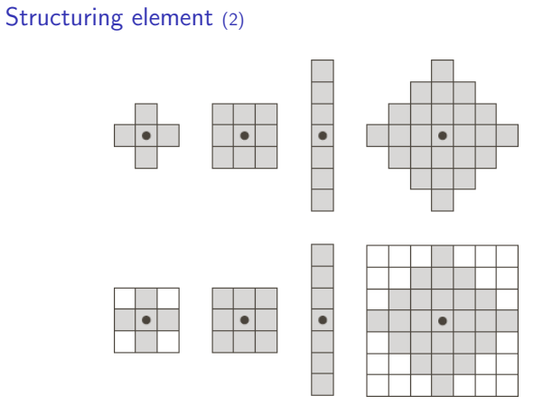

Slide 8
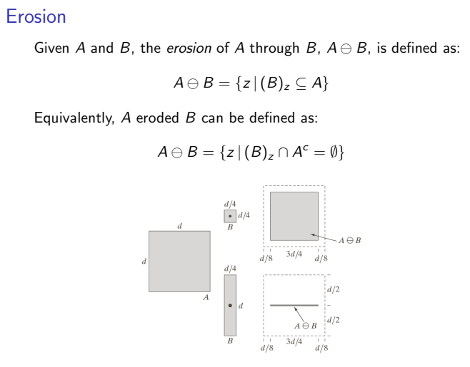

Slide 9
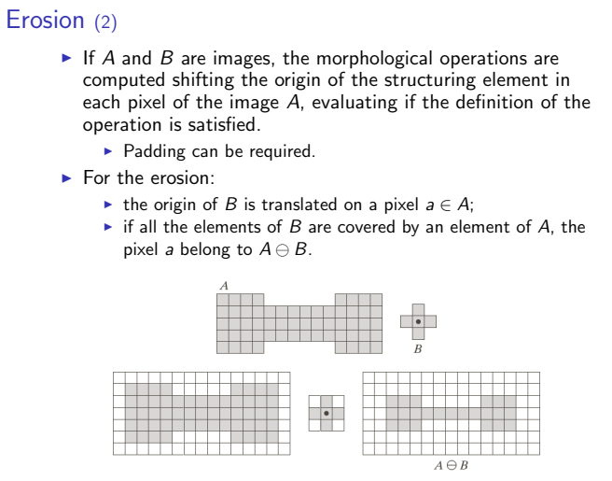
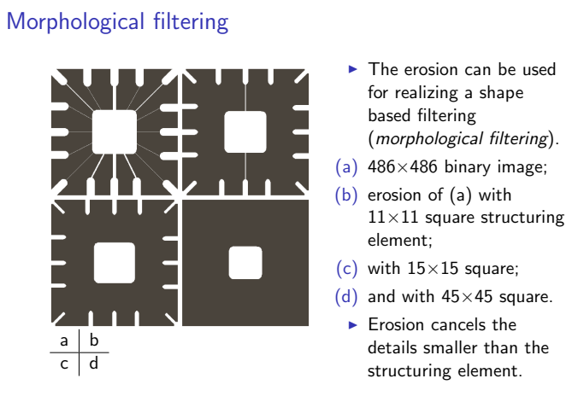

Slide 10
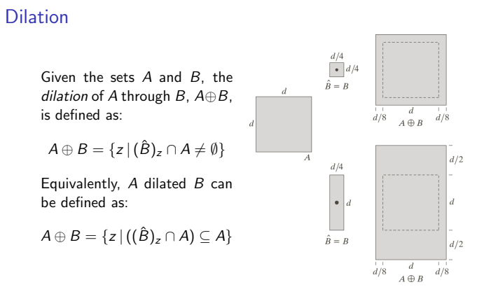

Slide 11
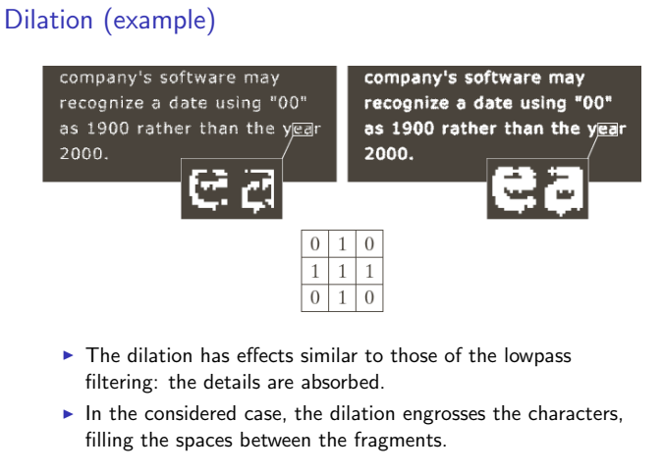

Slide 12
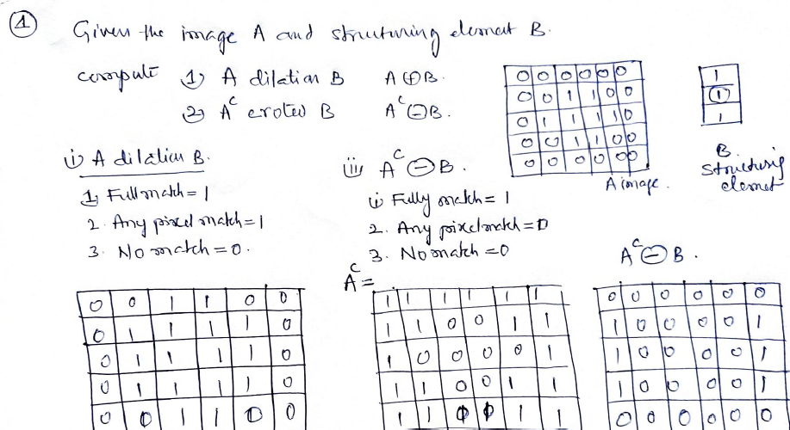

Slide 13
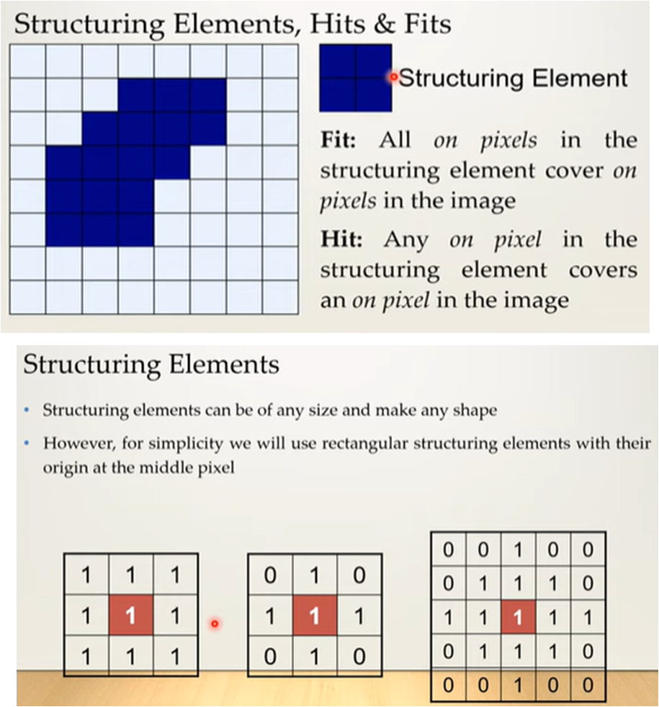
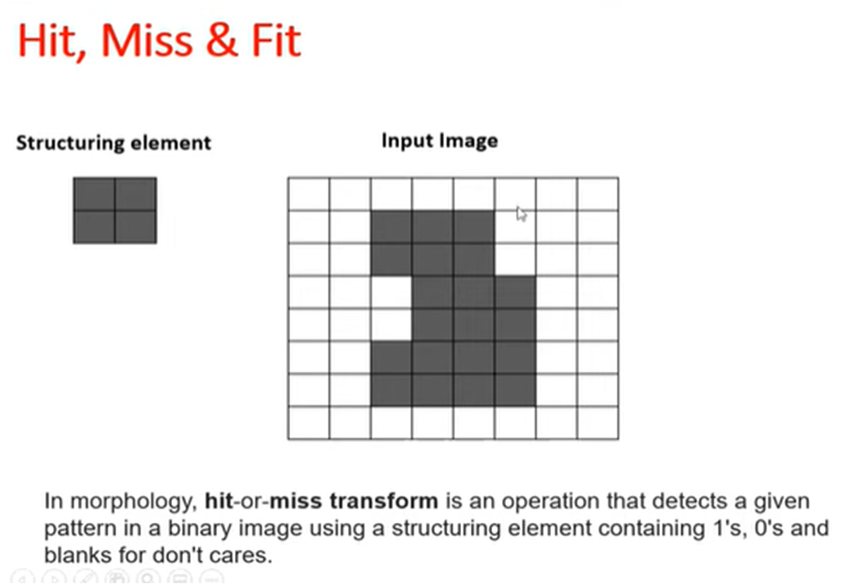
Structuring Element: A structuring element is a shape used to interact with a given image. It helps us to draw conclusions based on how it misses or fit in the image. It is used in morphological operations such as erosion, dilation, opening, closing, gradient, black-hat/top-hat transform.

Slide 14
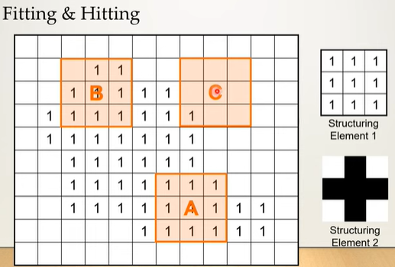

Slide 15
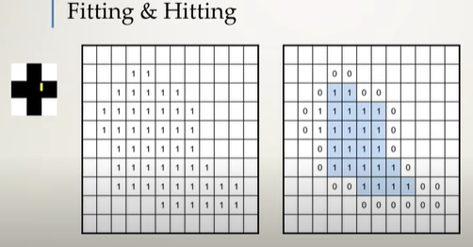
Fit=1
Hit=0

Slide 16
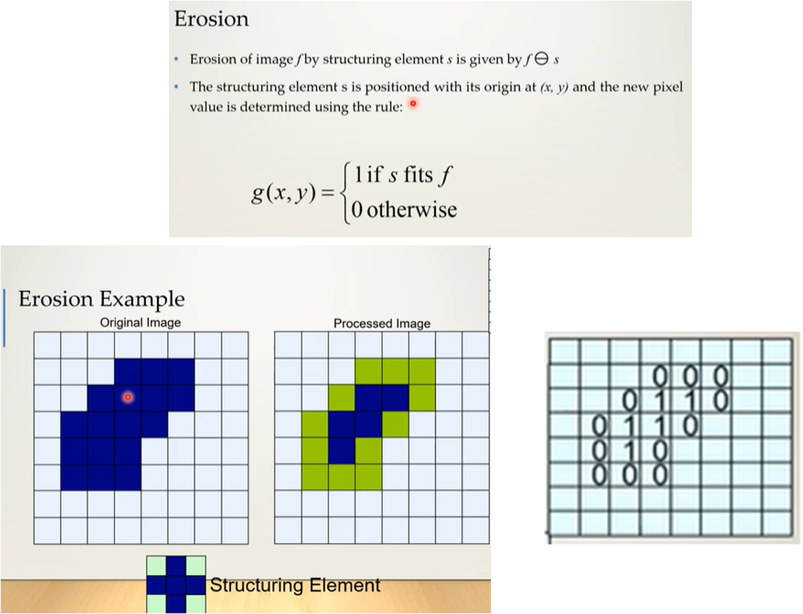
Erosion is the morphological operation used to diminish the size of the foreground object. It is just like soil erosion and erodes away the boundary of the foreground object.

Slide 17
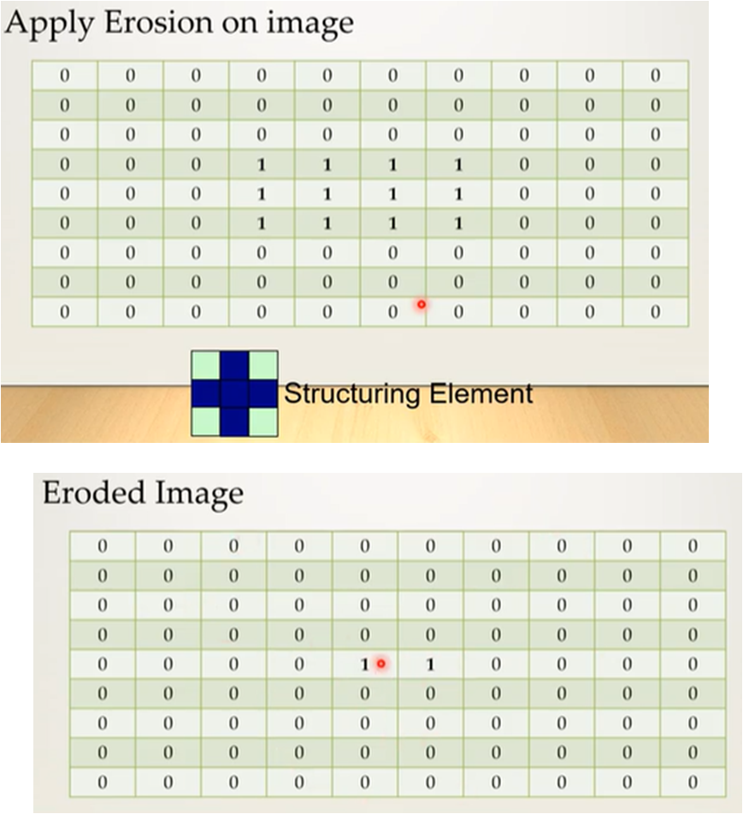

Slide 18
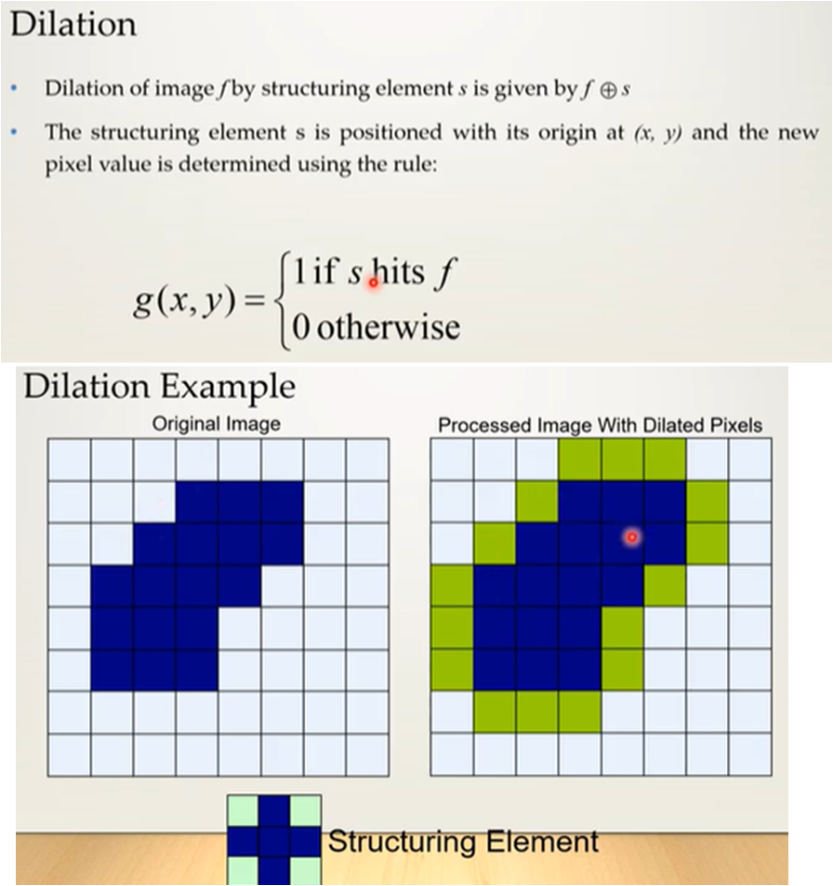
Dilation is the opposite of Erosion, instead of shrinking it expands the foreground object. In this operation structuring element(kernel) is slid through the image.

